Slide 1
DESIGN & ANALYSIS OF ALGORITHMS
PRESENTATION ON TOPICS OF :
ELEMENTARY GRAPHS AND ALGORITHMS
MINIMUM SPANNING TREE
SHORTEST PATH ALGORITHMS
SUBMITTED BY: M.VISHISTA
ROLL NO: 181210031
BRANCH: CSE, 2ND YEAR

Slide 2
Introduction to graphs
A data structure that consists of a set of nodes (vertices) and a set of edges. The set of edges describes relationships among the vertices .
A graph G is defined as follows: G = (V, E)
V(G): a finite, nonempty set of vertices
E(G): a set of edges (pairs of vertices)

Slide 3
GRAPHS
Graphs are non-linear data structures consisting of vertices(or nodes) and edges(or arcs).
Unlike trees, all nodes in graphs can have any number of incoming and outgoing edges whereas in trees, the root node cannot have any incoming edge.
This way, every tree is a graph but vice versa is not true.
There are 2 types of graphs: Undirected and Directed Graphs
In undirected graphs, an edge between nodes A and B can be used to traverse from A to B and from B to A. All edges are denoted without any arrows.
In directed graphs, all edges are denoted with an arrow and can be traversed on in the direction denoted by it.

Slide 4
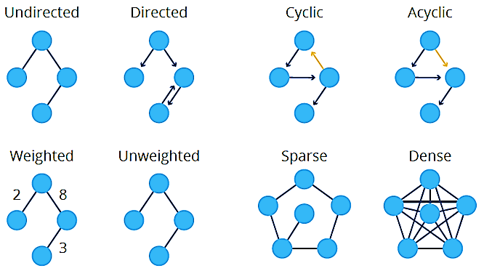
TYPES OF GRAPHS

Slide 5
BREADTH FIRST SEARCH
BFS stands for Breadth First Search is a vertex based technique for finding a shortest path in graph.
It uses a Queue data structure which follows first in first out.
In BFS, one vertex is selected at a time when it is visited and marked then its adjacent are visited and stored in the queue.
It is slower than DFS.

Slide 6
WORKING OF BFS
Step 1: SET STATUS = 1 (ready state) for each node in G
Step 2: Enqueue the starting node A and set its STATUS = 2 (waiting state)
Step 3: Repeat Steps 4 and 5 until QUEUE is empty
Step 4: Dequeue a node N. Process it and set its STATUS=3
(processed state).
Step 5: Enqueue all the neighbours of N that are in the ready state (whose STATUS = 1) and set their STATUS = 2 (waiting state)
[END OF LOOP]
Step 6: EXIT

Slide 7
FEATURES & APPLICATIONS
Time Complexity: O(|V| + |E|)
Completeness: This algorithm is a complete algorithm as it gives solution for any kind of graph .
Optimality: BFS is optimal for graph that has edges of equal length, since it always returns the result with fewest edges between the start node and goal node.
APPLICATIONS:
Finding all connected components in graph
Finding all nodes within individual connected component
Finding shortest path between two nodes ‘u’ and ‘v’ of an unweighted or weighted graph.

Slide 8
PSEUDOCODE OF BFS
BFS (G, s)
//Where G is the graph and s is the source node
let Q be queue.
Q.enqueue( s )
//Inserting s in queue until all its neighbor vertices are marked.
mark s as visited.
while ( Q is not empty)
//Removing that vertex from queue, whose neighbor will be visited now
v = Q.dequeue( )
//processing all the neighbors of v
for all neighbors w of v in Graph G
if w is not visited
Q.enqueue( w )
//Stores w in Q to further visit its neighbor
mark w as visited.

Slide 9
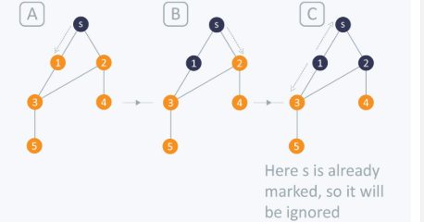
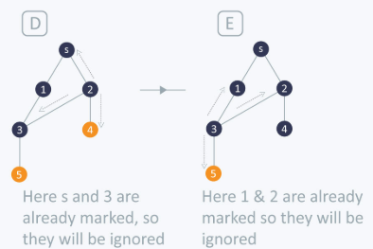
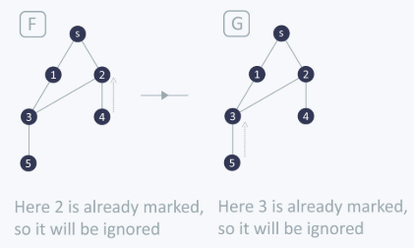
FLOW OF DFS

Slide 10
DEPTH FIRST SEARCH
DFS stands for Depth First Search is a edge based technique.
It uses the Stack data structure, performs two stages, first visited vertices are pushed into stack and second if there is no vertices then visited vertices are popped.
DFS traversal requires less memory storage.

Slide 11
Time Complexity: O(|V| + |E|)
Completeness: This algorithm is a complete algorithm as it gives solution for any kind of graph
Optimality: BFS is optimal for graph that has edges of equal length, since it always returns the result with fewest edges between the start node and goal node.
APPLICATIONS:
Finding all connected components in graph
Finding all nodes within individual connected component
Finding shortest path between two nodes ‘u’ and ‘v’ of an unweighted or weighted graph.

Slide 12
WORKING OF DFS
Step 1: SET STATUS = 1 (ready state) for each node in G
Step 2: Push the starting node A on stack and set its STATUS = 2 (waiting state)
Step 3: Repeat Steps 4 and 5 until STACK is empty
Step 4: Pop the top node N. Process it and set its STATUS=3 (processed state).
Step 5: Push all the neighbors of N on to the stack that are in the ready state (whose STATUS = 1) and set their STATUS = 2 (waiting state)
[END OF LOOP]
Step 6: EXIT

Slide 13
PSEUDOCODE OF DFS
DFS-iterative (G, s): //Where G is graph and s is source vertex
let S be stack
S.push( s ) //Inserting s in stack
mark s as visited.
while ( S is not empty):
//Pop a vertex from stack to visit next
v = S.top( )
S.pop( )
//Push all the neighbors of v in stack that are not visited
for all neighbors w of v in Graph G:
if w is not visited :
S.push( w )
mark w as visited
DFS-recursive(G, s):
mark s as visited
for all neighbors w of s in Graph G:
if w is not visited:
DFS-recursive(G, w)

Slide 14
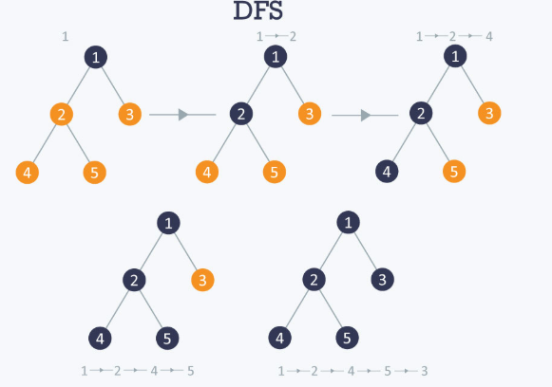
FLOW OF DFS

Slide 15
MINIMUM SPANNING TREE
A spanning tree is a sub-graph of an undirected and a connected graph, which includes all the vertices of the graph having a minimum possible number of edges.
The total number of spanning trees with n vertices that can be created from a complete graph is equal to n^(n-2).
A minimum spanning tree is a spanning tree in which the sum of the weight of the edges is as minimum as possible.
The minimum spanning tree from a graph is found using the following algorithms:
Prim's Algorithm
Kruskal's Algorithm

Slide 16
PRIM’S ALGORITHM
Prim's algorithm is a greedy algorithm that finds a minimum spanning tree for a weighted undirected graph.
This means it finds a subset of the edges that forms a tree that includes every vertex, where the total weight of all the edges in the tree is minimized.
The algorithm operates by building this tree one vertex at a time, from an arbitrary starting vertex, at each step adding the cheapest possible connection from the tree to another vertex.
TIME COMPLEXITY: O(E Log(V))

Slide 17
WORKING OF ALGORITHM
Step 1 -Initialize the minimum spanning tree with a vertex chosen at random.
Step 2 -Find all the edges that connect the tree to new vertices, find the minimum and add it to the tree. If adding the vertices creates a cycle, then reject this edge.
Step 3 -Keep repeating step 2 until we get a minimum spanning tree.

Slide 18
KRUSKAL’S ALGORITHM
Kruskal's algorithm is a minimum-spanning-tree algorithm which finds an edge of the least possible weight that connects any two trees in the forest.
It is a greedy algorithm in graph theory as it finds a minimum spanning tree for a connected weighted graph adding increasing cost arcs at each step.
This means it finds a subset of the edges that forms a tree that includes every vertex, where the total weight of all the edges in the tree is minimized.
If the graph is not connected, then it finds a minimum spanning forest (a minimum spanning tree for each connected component).
Time Complexity: O(E Log(V))

Slide 19
WORKING OF ALGORITHM
Step 1: Create a forest in such a way that each graph is a separate tree
Step 2: Create a priority queue Q that contains all edges of the graph.
Step 3: Repeat steps 4 and 5 while Q is not empty
Step 4: Remove an edge from Q
Step 5: IF the edge obtained in step 4 connects two trees then add it to forest.
ELSE discard the edge
[End of loop]
Step 6: EXIT

Slide 20
DIJKSTRA’S ALGORITHM
Dijkstra's algorithm (or Single source Shortest Path algorithm) is an algorithm for finding the shortest paths between nodes in a graph. Example of greedy method approach.
Dijkstra's original algorithm found the shortest path between two given nodes, but a more common variant fixes a single node as the "source" node and finds shortest paths from the source to all other nodes in the graph, producing a shortest-path tree.
For a given source node in the graph, the algorithm finds the shortest path between that node and every other.
It can also be used for finding the shortest paths from a single node to a single destination node by stopping the algorithm once the shortest path to the destination node has been determined.
Time Complexity: O(V^2)

Slide 21
WORKING OF ALGORITHM
Step 1 -Set all vertices distances = infinity except for the source vertex, set the source distance =0.
Step2 –Push the source vertex in a min-priority queue in the form (distance , vertex), as the comparison in the min-priority queue will be according to vertices distances.
Step3-Pop the vertex with the minimum distance from the priority queue(at first the popped vertex=source).
Step4 –Update the distances of the connected vertices to the popped vertex in case of “ current vertex distance + edge weight <next vertex distance “ then push the vertex with the new distance to the priority queue.
Step5 –If the popped vertex is visited before , just continue without using it.
Step6 –Apply the same algorithm again until the priority queue is empty.

Slide 22
PSEUDOCODE
function Dijkstra(Graph, source):
create vertex set Q
for each vertex v in Graph:
dist[v] ← INFINITY
prev[v] ← UNDEFINED
add v to Q
dist[source] ← 0
while Q is not empty:
u ← vertex in Q with min dist[u]
remove u from Q
for each neighbor of u:
// only v that are still in Q
alt ← dist[u] + length(u, v)
if alt < dist[v]:
dist[v] ← alt
prev[v] ← u
return dist[], prev[]

Slide 23
FLOYD WARSHALL’S ALGORITHM
Floyd-Warshall algorithm(or all pair shortest algorithm) is an algorithm for finding shortest paths in a weighted graph with positive or negative edge weights.
All pair shortest paths that returns the shortest paths between every of vertices in graph that can contain negative edge weights.
It is an example of dynamic programming approach
Time Complexity: O(V^3)

Slide 24
WORKING OF ALGORITHM
Step 1 -Initialize the shortest paths between any two vertices with Infinity.
Step 2 -Find all pair shortest paths that use zero intermediate vertices, then find the shortest paths that use one intermediate vertex and so on.. until using all N vertices as intermediate nodes.
Step 3 -Minimize the shortest paths between any two pairs in the previous operation.
Step 4 -For any two vertices(i , j), one should actually minimize the distances between this pair using the first K nodes, so the shortest path will be:
min(dist[i][k]+dist[k][j],dist[i][j])

Slide 25
PSEUDOCODE
let dist be a |V| × |V| array of minimum distances initialized to ∞ (infinity)
for each edge (u, v) do
dist[u][v] ← w(u, v)
// The weight of the edge (u, v)
for each vertex v do
dist[v][v] ← 0
for k from 1 to |V|
for i from 1 to |V|
for j from 1 to |V|
if dist[i][j] > dist[i][k] + dist[k][j]
dist[i][j] ← dist[i][k] + dist[k][j]
end if

Slide 26
END OF SLIDES
THANK YOU

